Slide 1
Public Opinion on Student Loan Forgiveness
By:
Arunaggiri Pandian Karunanidhi
Amaan Mujtaba Jaweed

Slide 2
Student Loans
Interesting facts about student loans.
A student loan is the money a student borrows from federal government or private lender to help pay for college.
42.8 million people have federal student debt.
Student loan debt totals 1.745 trillion dollars
An average student borrows around 35k dollars to attain a bachelor’s degree

Slide 3
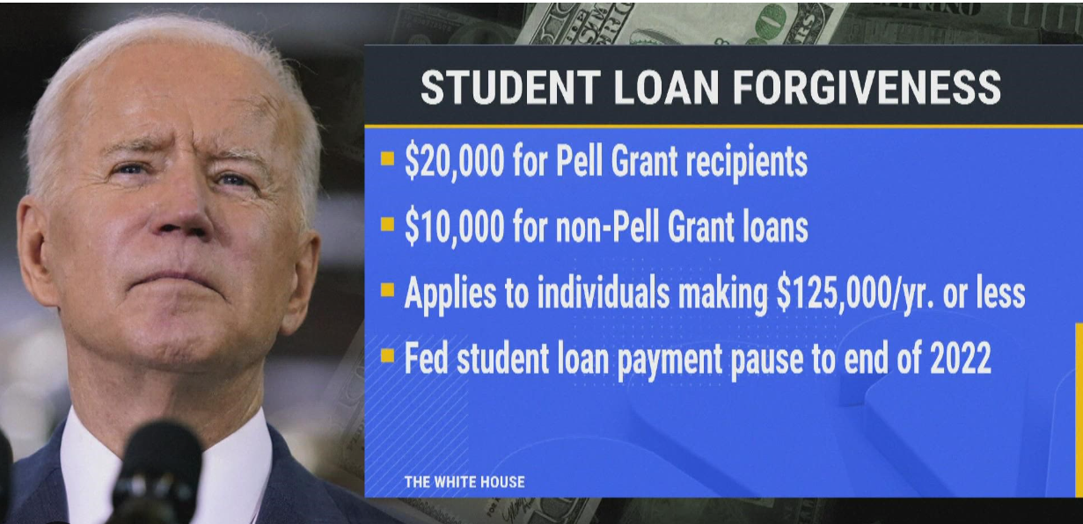
Student Loan Forgiveness

Slide 4
Understanding Student Loan Forgiveness
if(borrower.annualIncome <= 125000):
borrower.eligible = True
if(borrower.pellGrantRecipient == True): #Family income less than median
borrower.eligibility = 20000
else: #Family income more than median
borrower.eligibility = 10000
else: #Annual income more than 125000
borrower.eligible = False

Slide 5
Public Opinion: For? Against? Mixed?
Pros:
The proposal would entirely wipe out student debt for 20 million people
Cons:
People argue whether forgiving student loans is the best way to spend an estimated $500 billion.
It is not fair to other people, who had recently paid off their loans.
Might lead to Inflation.

Slide 6
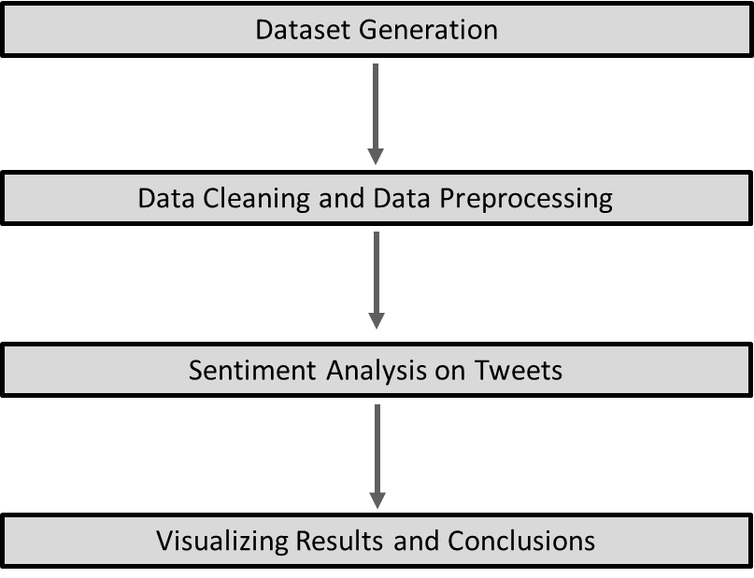
Public Opinion from Tweets: Methodology

Slide 7
Dataset Collection
Our data source is twitter and tweets will be our data.
Using snscrape, we collect all tweets based on hashtags and we store it in our custom dataset
Example: All tweets that contain #studentloanforgiveness would be included in the dataset.
Hashtags included:
#studentloanforgiveness
#studentloan
#studentloandebt
#studentdebt
#studentdebtbomb
#loanforgiveness

Slide 8
Data Preprocessing
This is essentially an NLP task. This step involves:
Removal of all hashtags from the tweet
Lower-casing of the tweet
Removal of stopwords
Removing numbers from the tweet
Removing urls from the tweet
Removing punctuations from the tweet
Removal of any special characters, symbols etc.

Slide 9
Sentiment Analysis on the Tweets - VADER
We determine if the tweet is positive or negative or neutral in this step
For semantic analysis, we used VADER sentiment analyzer from the nltk package.
VADER( Valence Aware Dictionary Sentiment Reasoner) is a lexicon and rule based sentiment analysis tool built on top of LIWC and ANEW, that is specifically attuned to sentiments expressed in social media.
VADER not only tells us if the sentence is positive or negative, it also tells us how positive or negative a sentiment is.

Slide 10
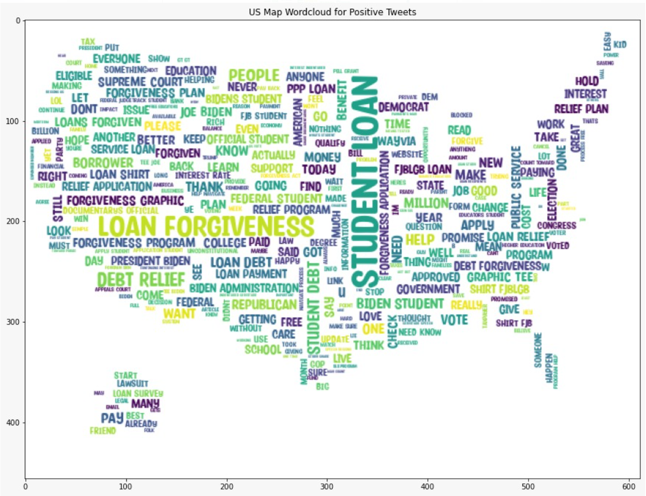
Word Cloud

Slide 11
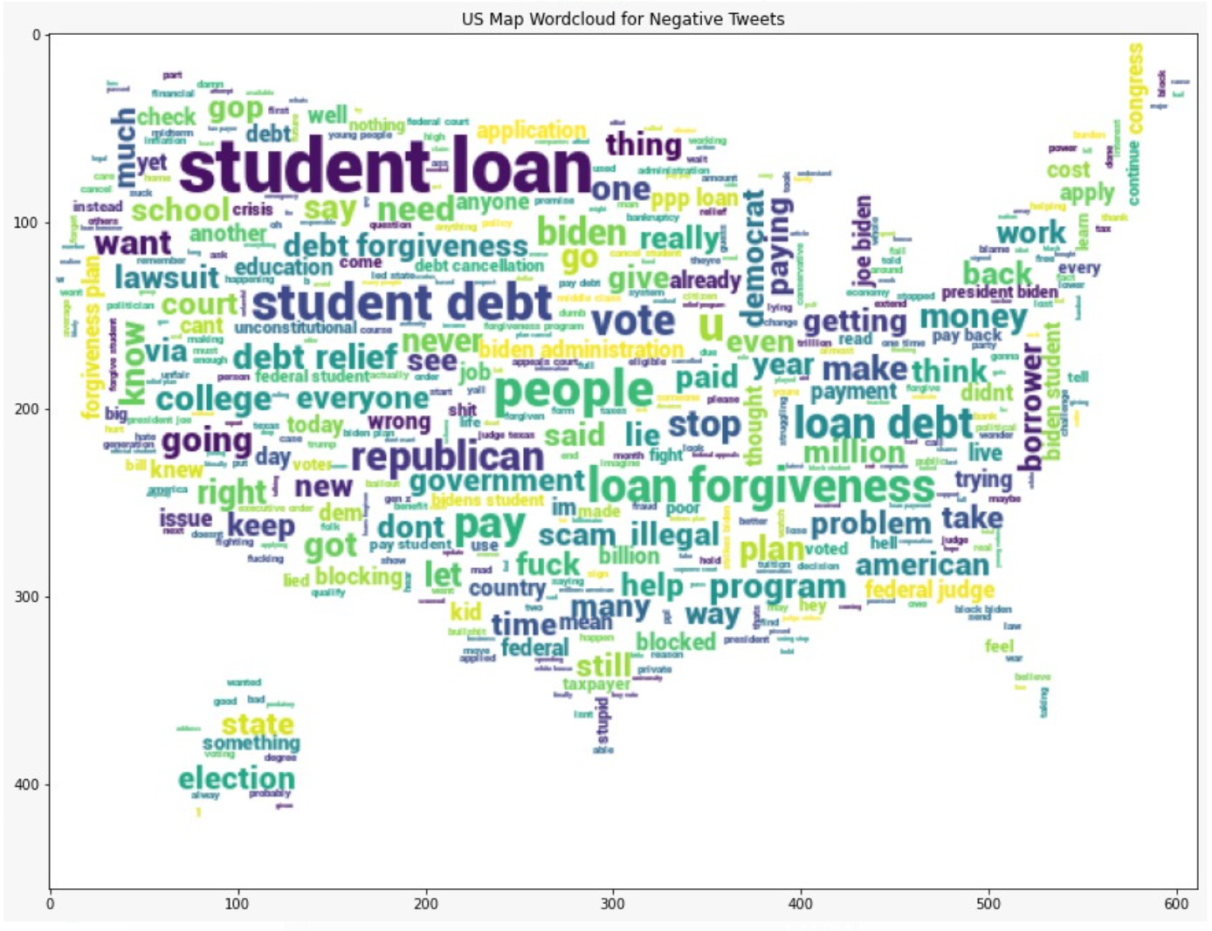
Word Cloud

Slide 12
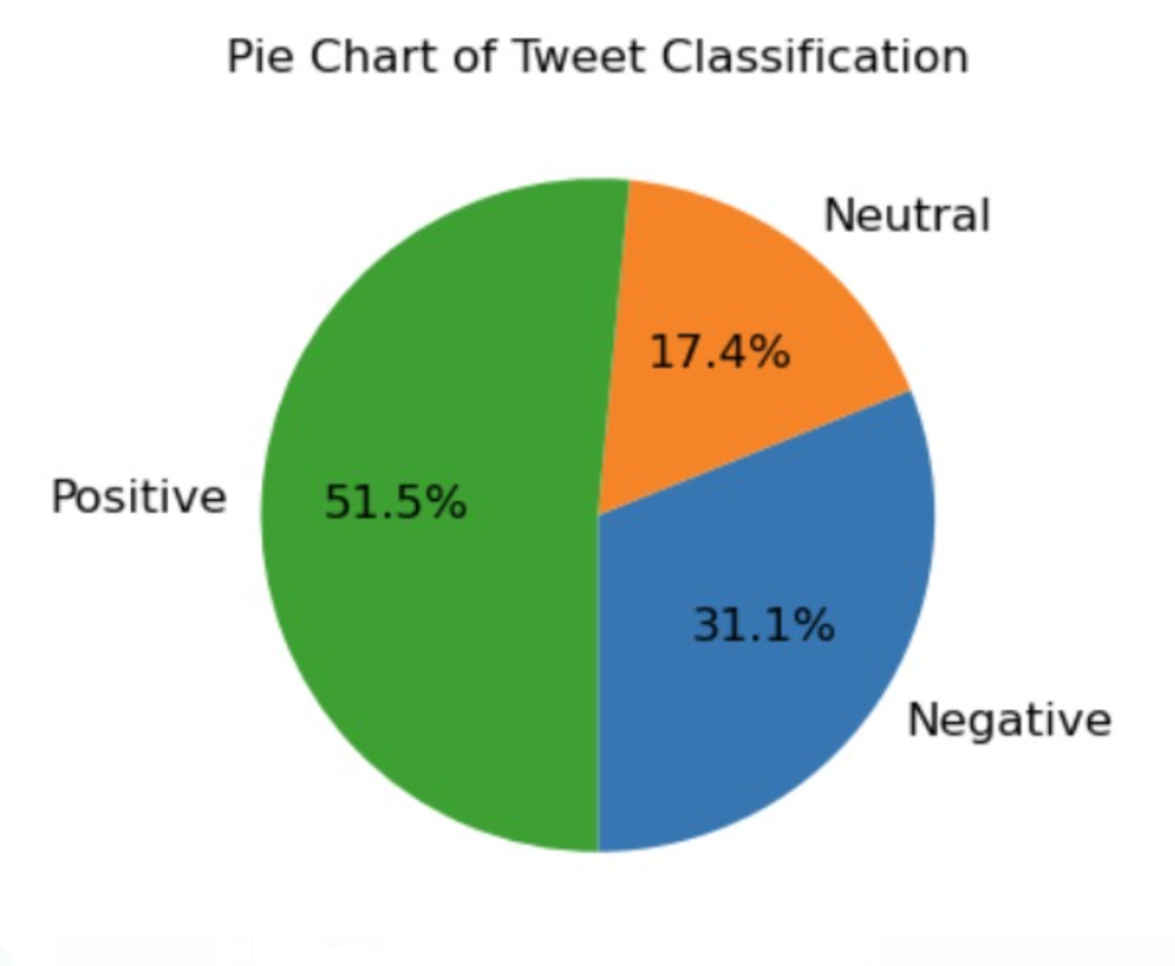
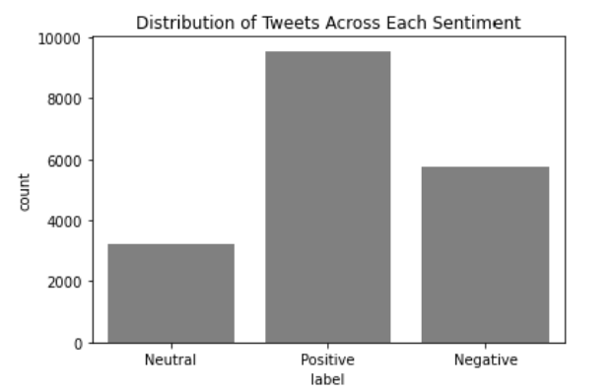
Visualising results and Conclusions

Slide 13
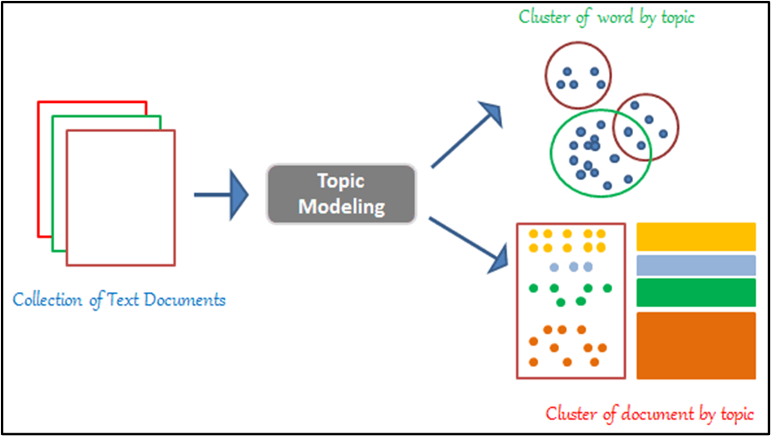
Topic Modeling using LDA
Latent Dirichlet Allocation (LDA) is a generative probabilistic model in which a varying proportion of themes are considered to make up each text in the model.

Slide 14
LDA Implementation
Along with the Mallet's implementation, we utilized the Latent Dirichlet Allocation (LDA) from the Gensim package (via Gensim). Mallet has a successful LDA implementation. It is reputed to operate more quickly and provide greater topic separation.
To determine how important a topic is, we will also extract the volume and percentage contribution of each topic.
Positive Tweets
Topic – 1: Benefits
Topic – 2: Relief
Topic – 3: Money
Negative Tweets
Topic – 1: Borrower
Topic – 2: Plan
Topic – 3: Debt
Neutral Tweets
Topic – 1: People
Topic – 2: Application
Topic – 3: Education

Slide 15
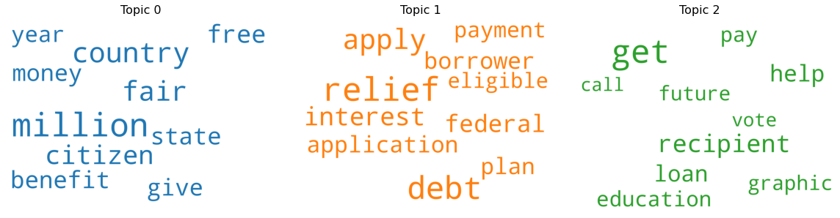
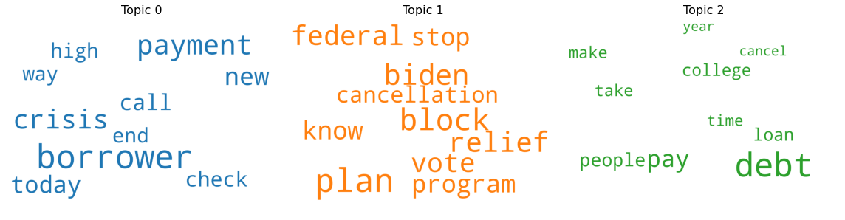
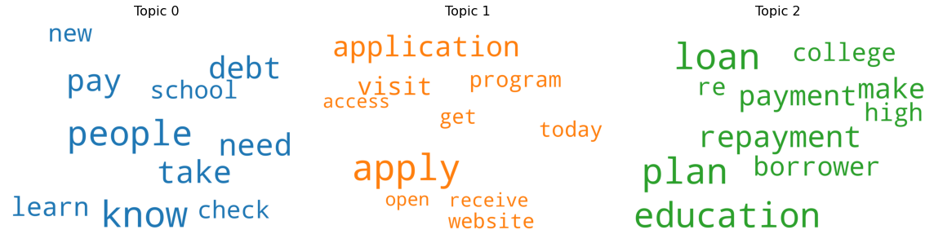
Word Cloud of Top 10 Keywords in Each Topic
Positive
Negative
Neutral

Slide 16
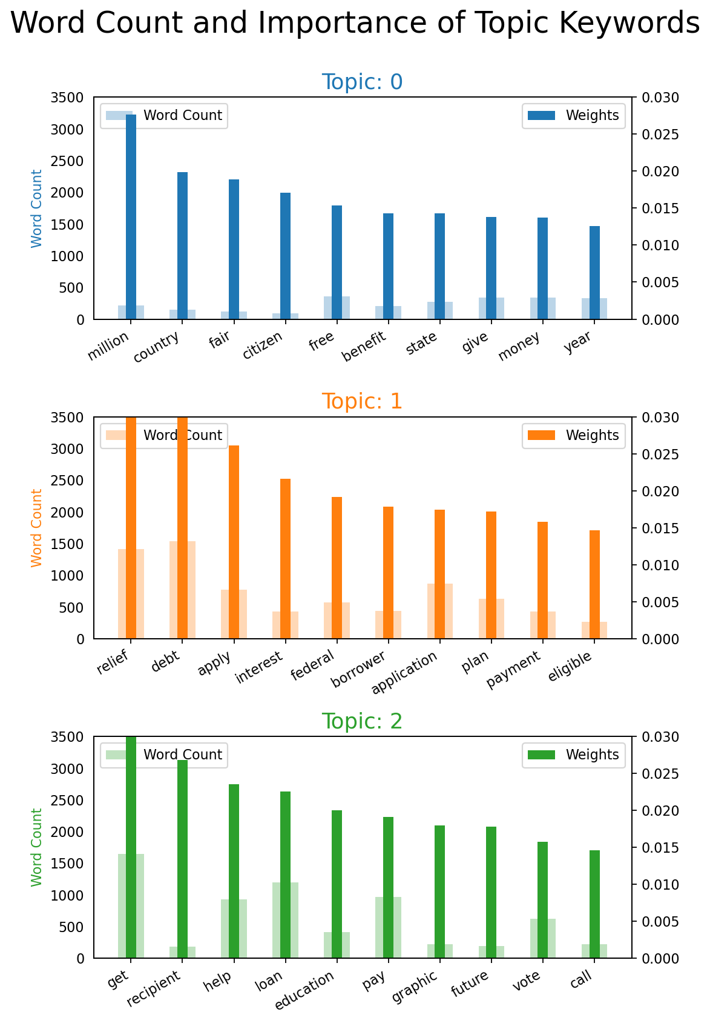
Word Cloud of Top 10 Keywords in Each Topic
Positive

Slide 17
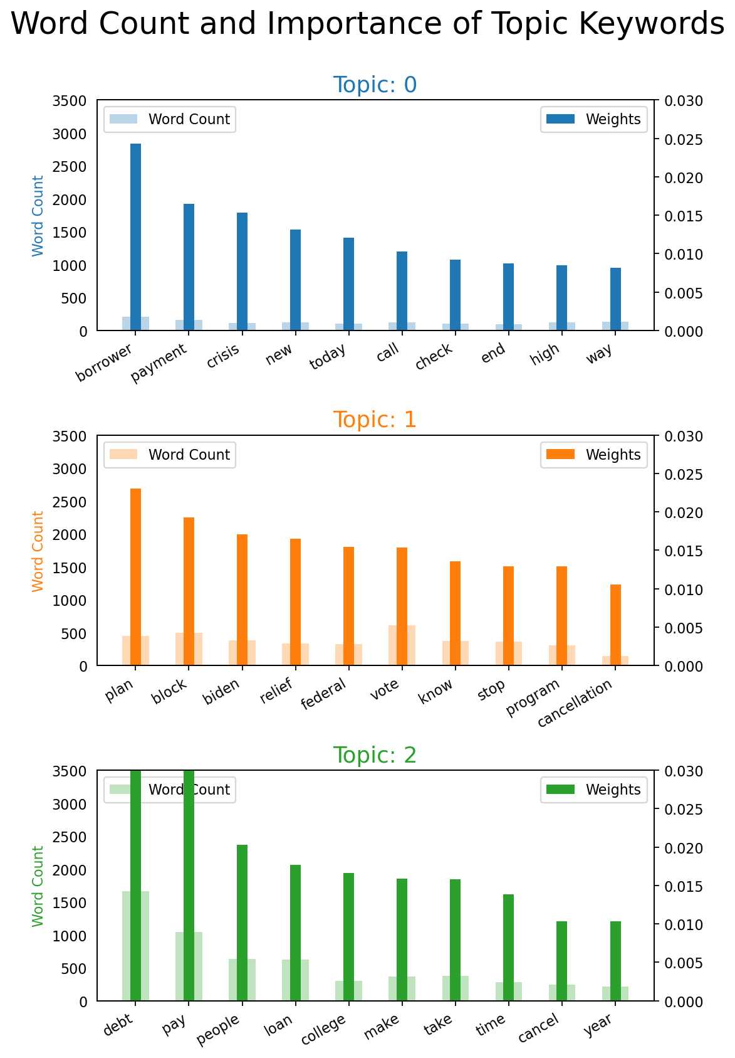
Word Cloud of Top 10 Keywords in Each Topic
Negative

Slide 18
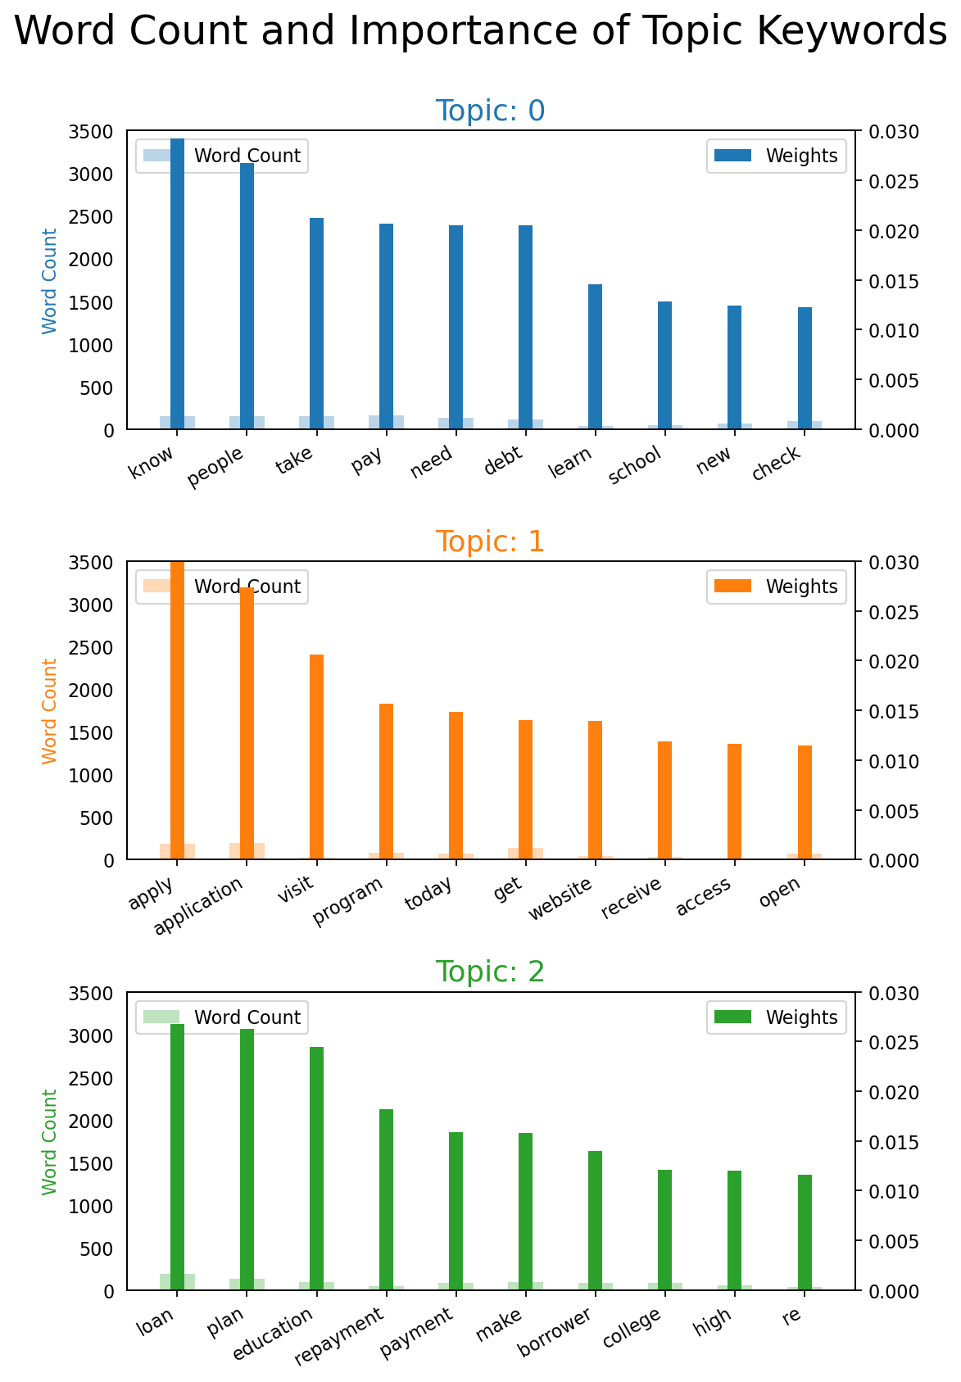
Word Cloud of Top 10 Keywords in Each Topic
Neutral

Slide 19
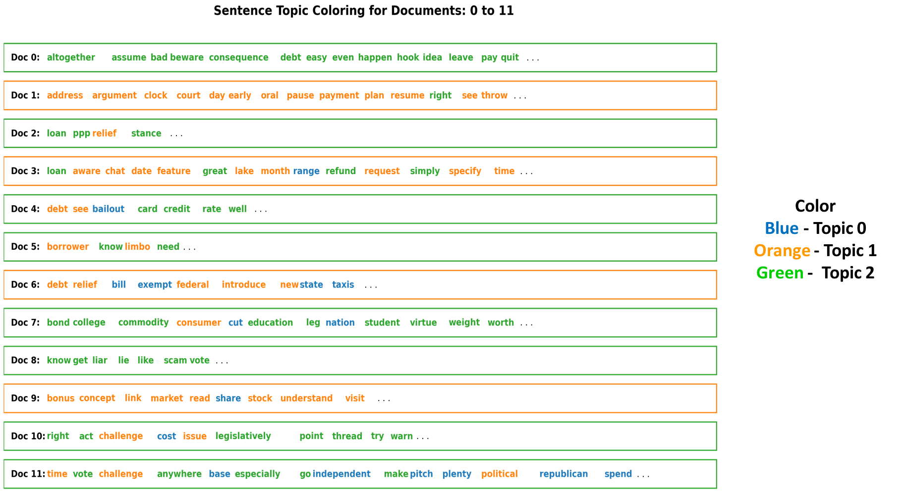
Sentence Chart Colored by Topic
Positive

Slide 20
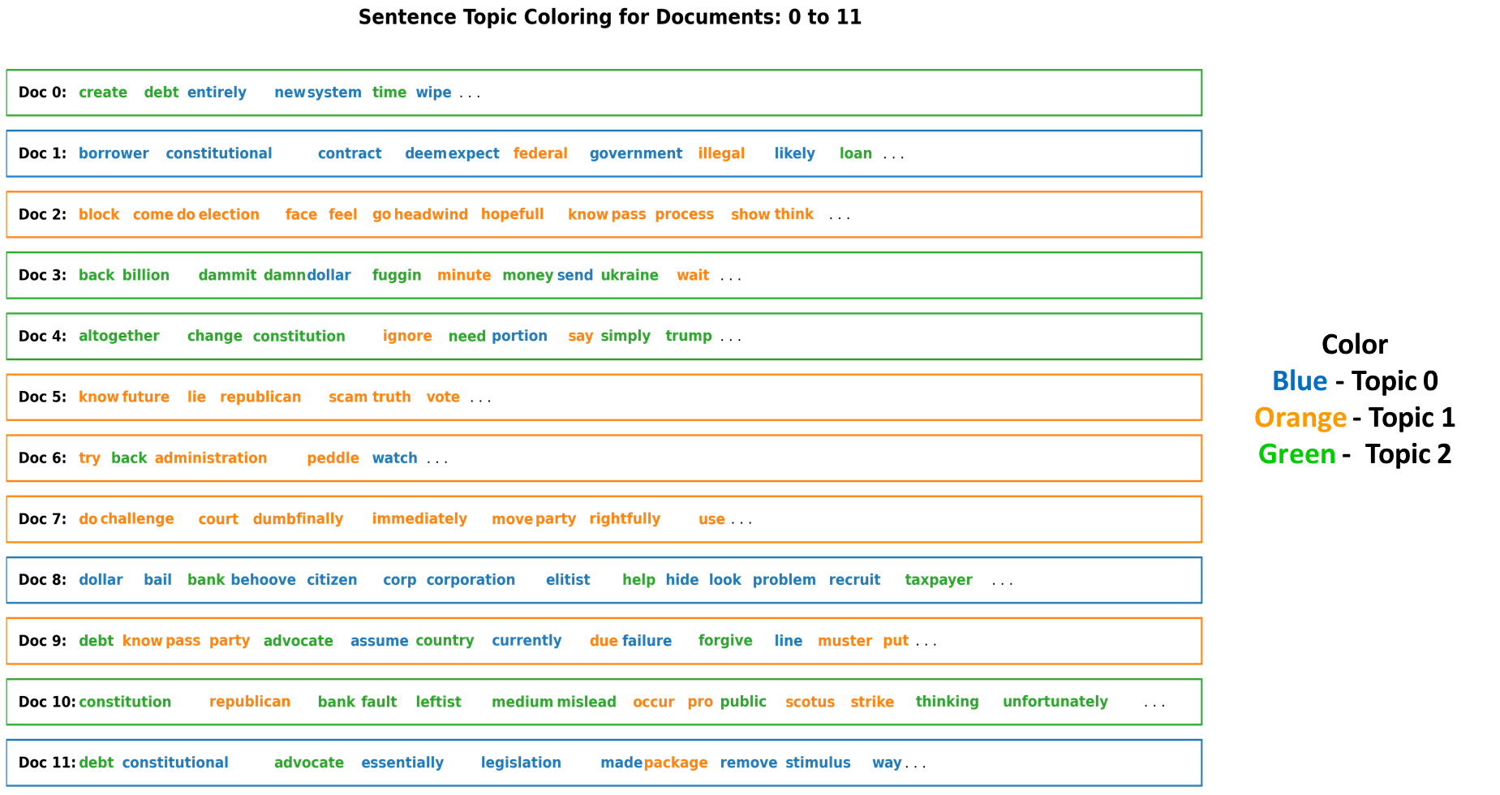
Sentence Chart Colored by Topic
Negative

Slide 21
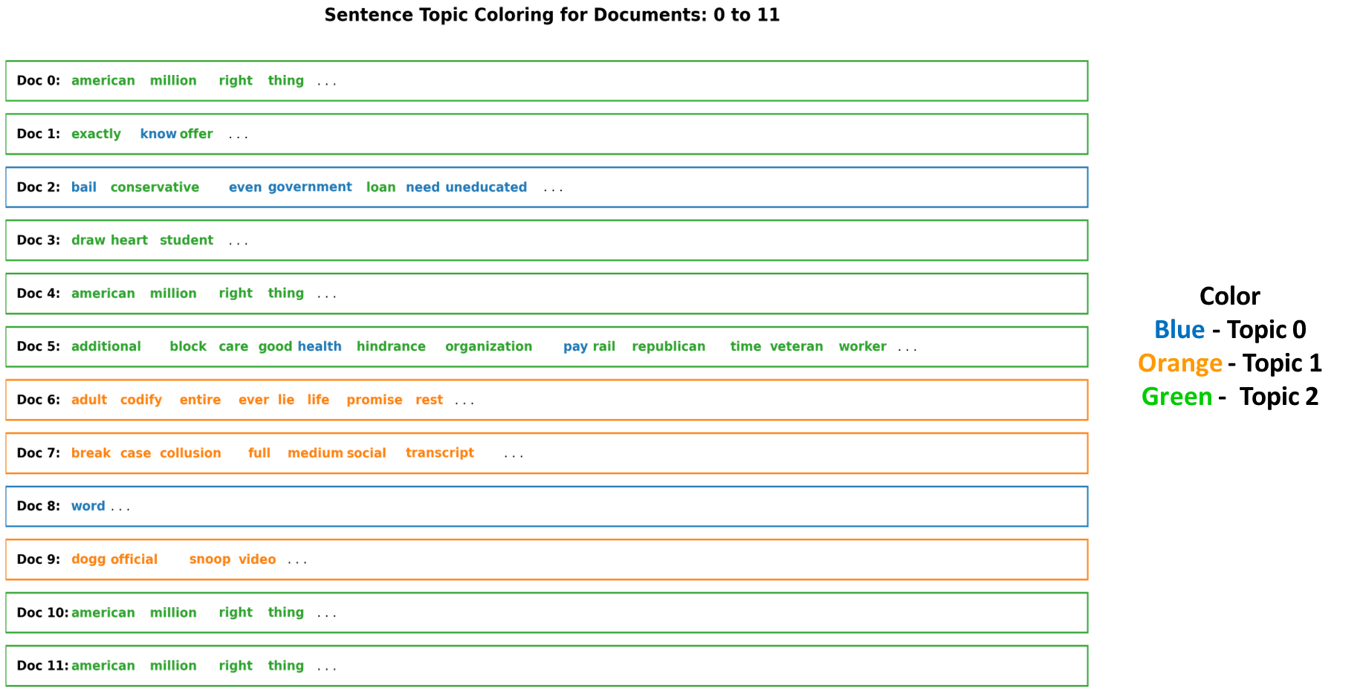
Sentence Chart Colored by Topic
Neutral

Slide 22
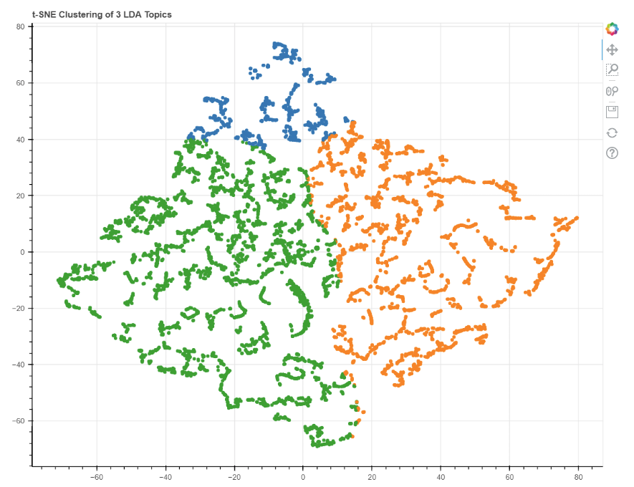
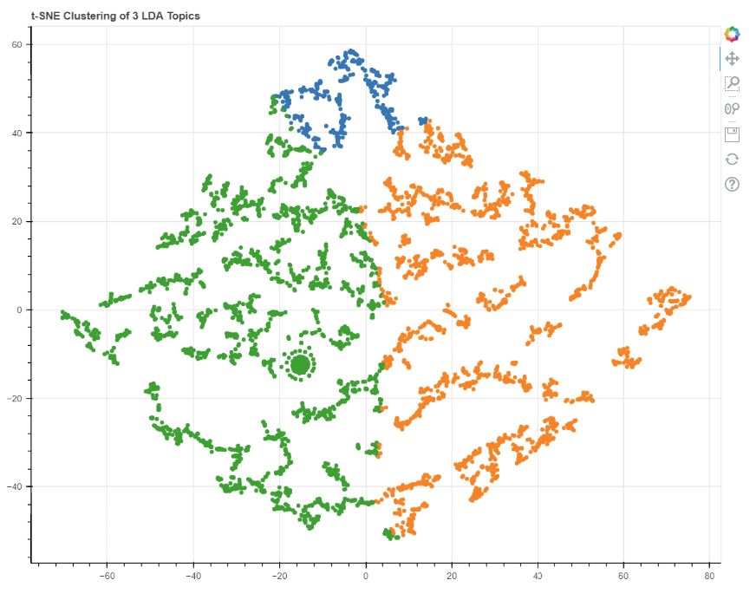
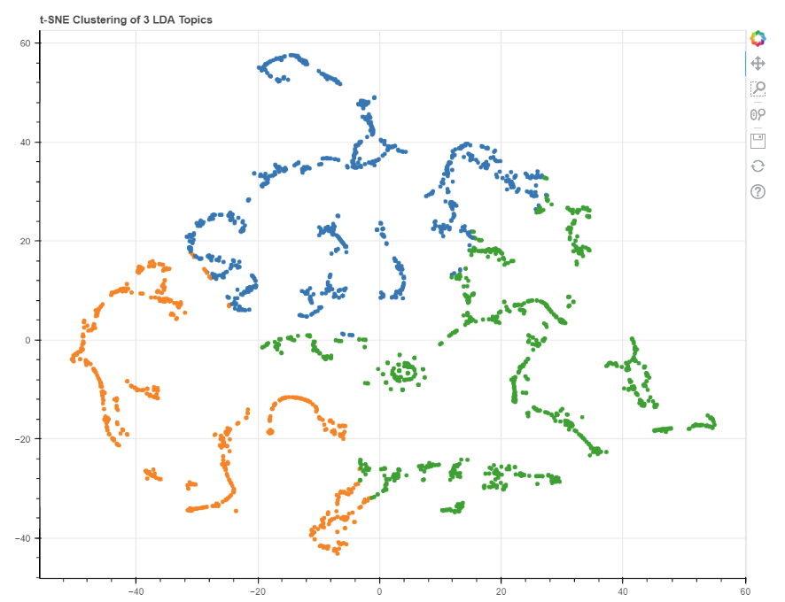
Clusters of Documents using t-SNE Algorithm
Positive
Negative
Neutral

Slide 23
Future Work
Finding relations between the age of a person and his opinion towards loan forgiveness
Finding relationship between gender of the person and their opinion towards loan forgiveness
Idea: We get the age and gender of the twitter user from their profile pictures (They should have only 1 face in the picture)
Pitfall: Since the topic is relatively new, there is not enough data to figure out the relations.

Slide 24
Thank You

